Slide 1
Modeling Data Validation
https://github.com/sheshankkodam/json-validations

Slide 2
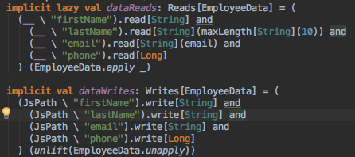
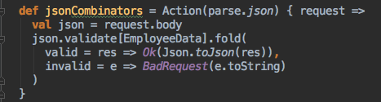
Json Combinators

Slide 3
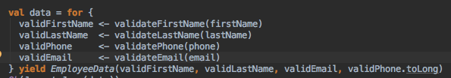




Options

Slide 4
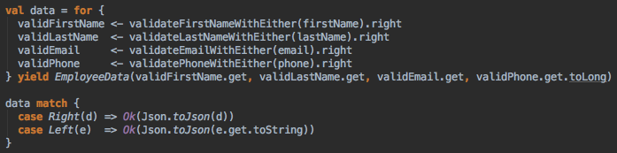




Either

Slide 5
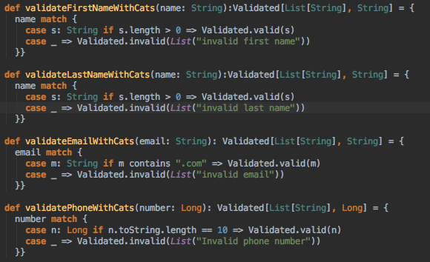
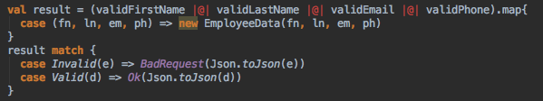
CATS

Slide 6
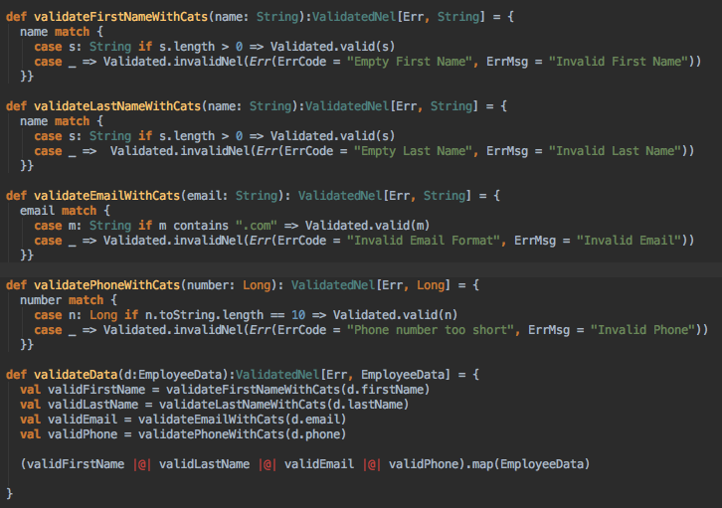

CATS more …

Slide 7
Final Solution Recommended
Use Json Combinators + CATS

